Slide 1
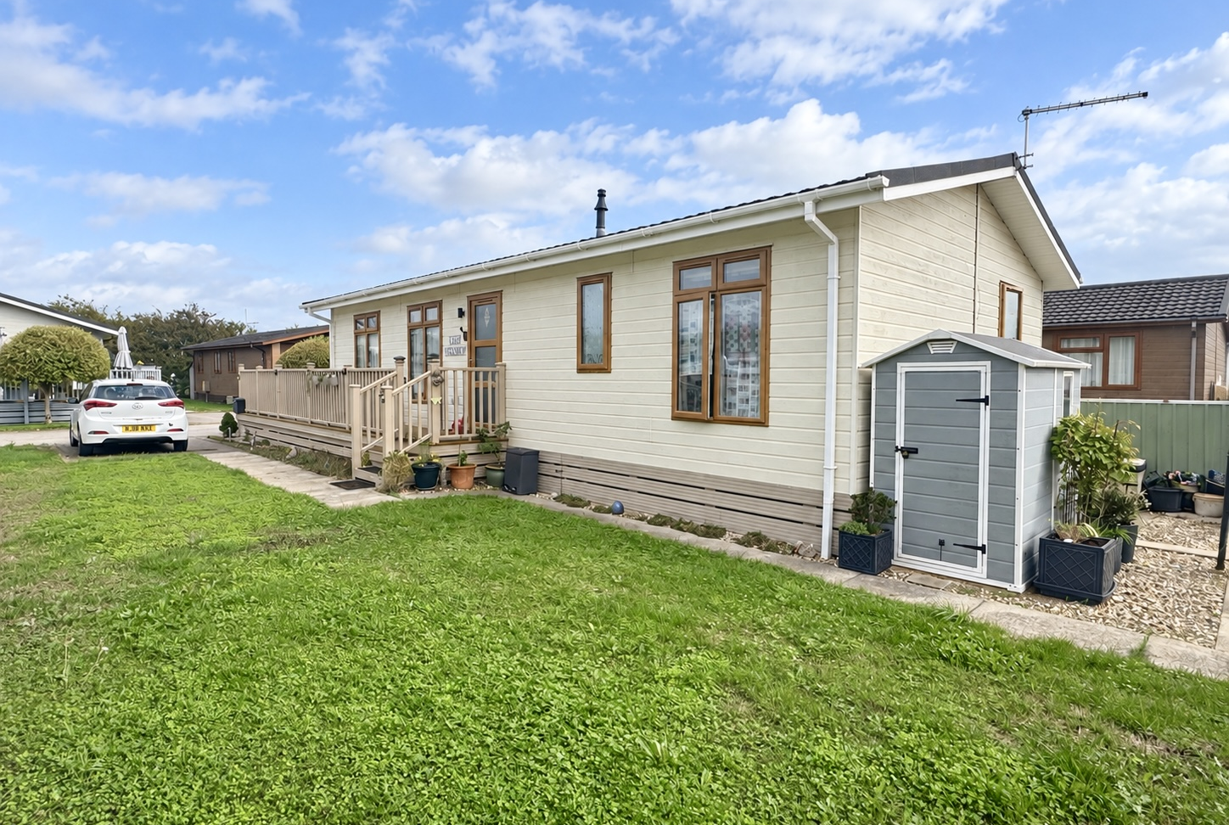
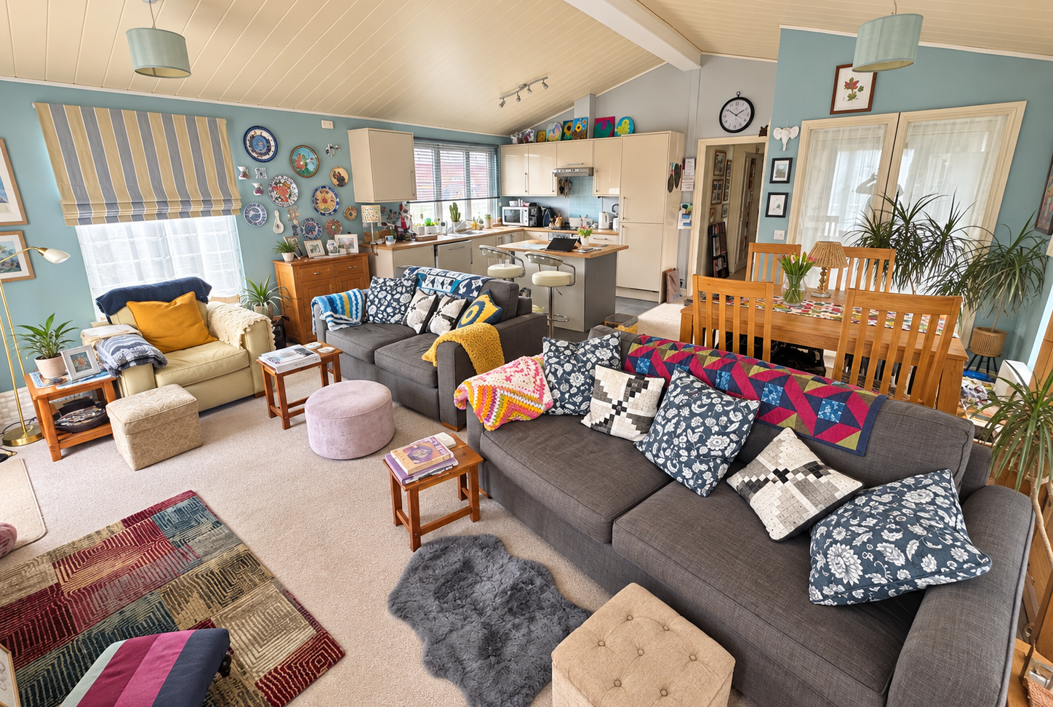
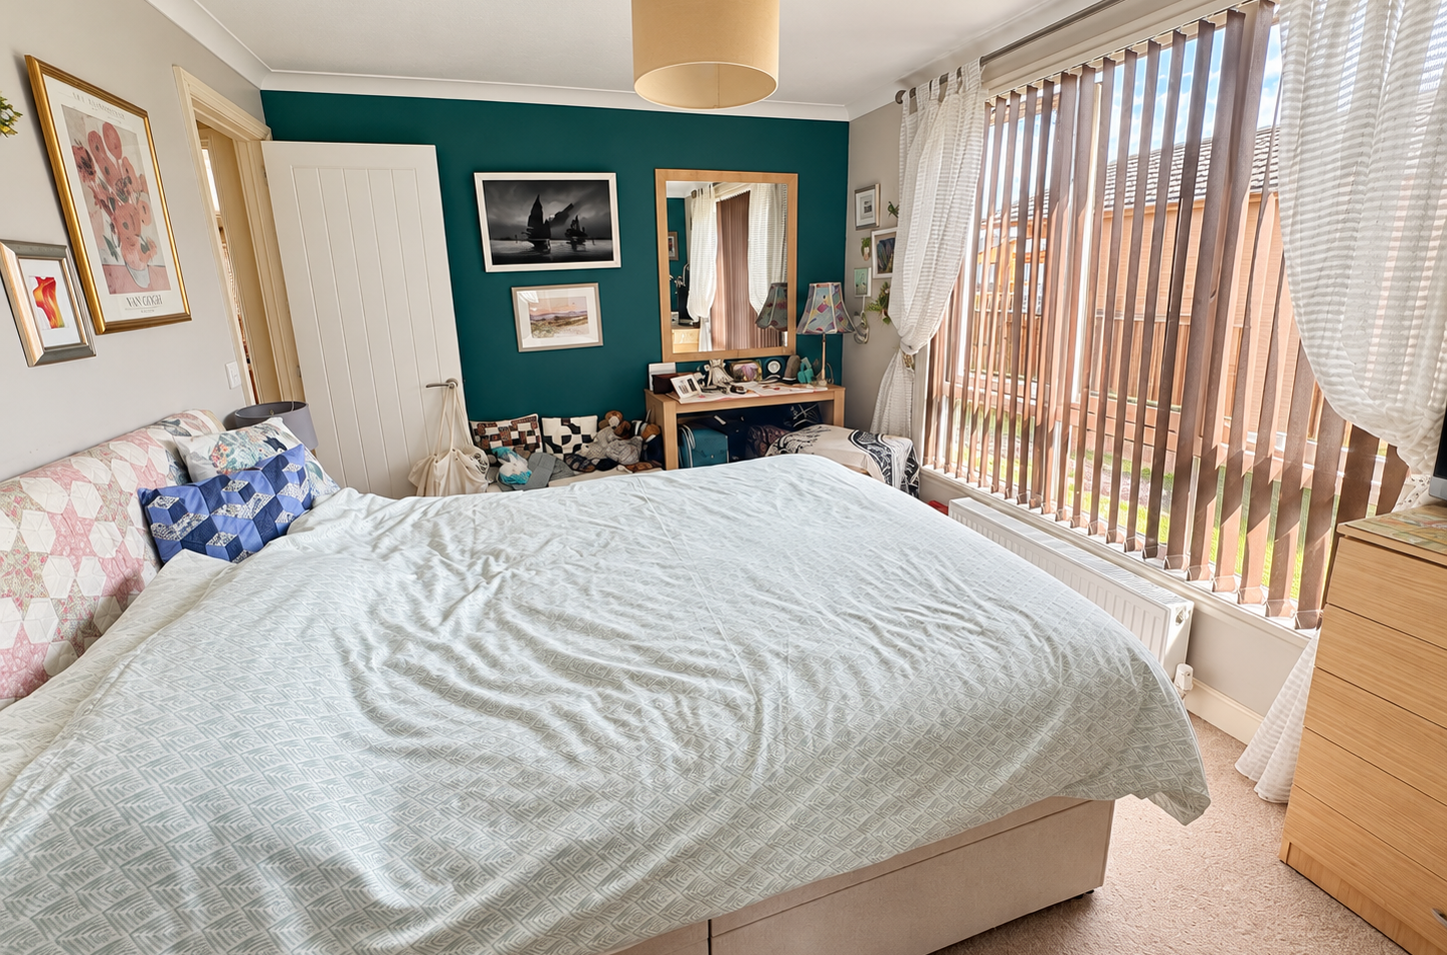
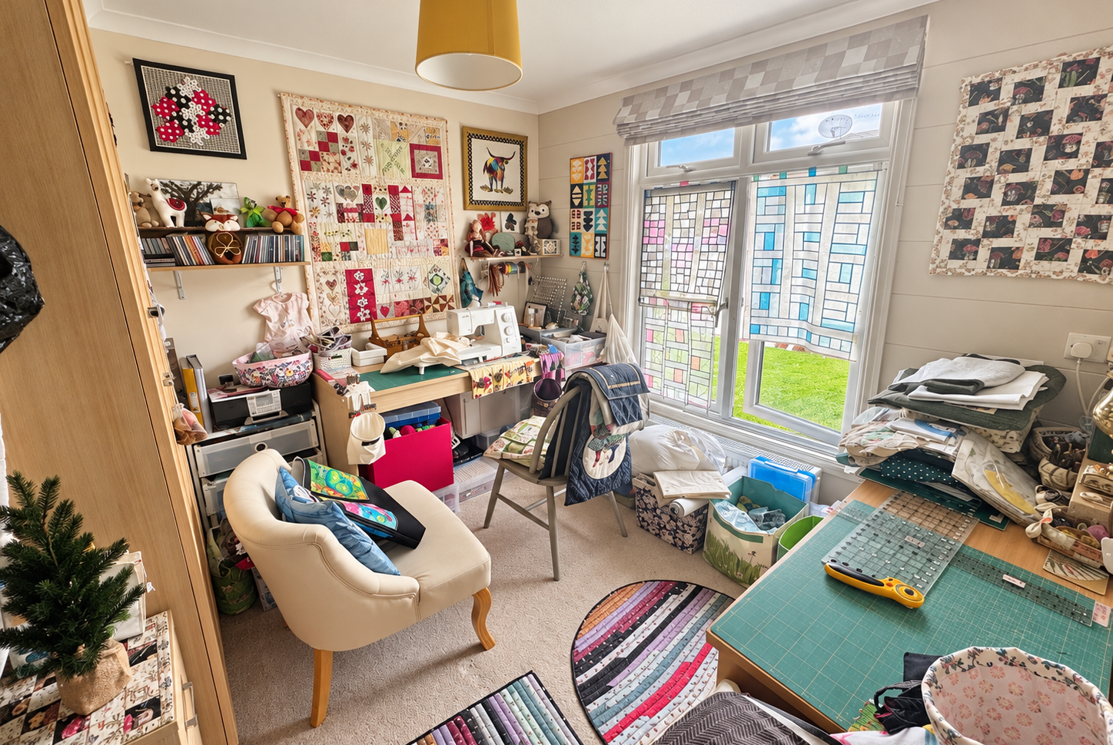
40 Lazy Otter Meadows
Cambridge Road, Stretham, Ely, CB6 3FS
Guide Price £130,000
2
2
1
A
This nicely located and open plan 40' park/lodge home is situated on this popular site which has secure gated access. The property has 2 bedrooms, dressing room, ensuite, large open plan living/ kitchen/diner and bathroom. Other benefits include double glazing, LPG heating and allocated parking. Cash purchasers only.

Slide 2
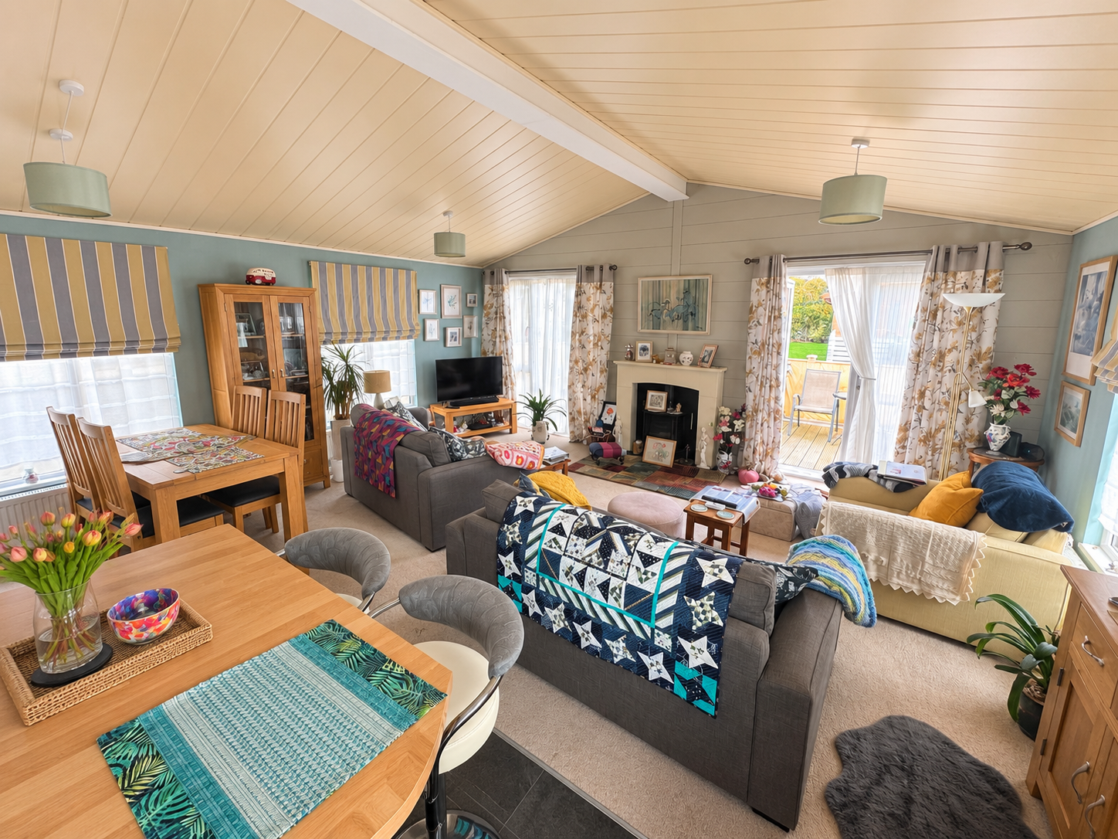
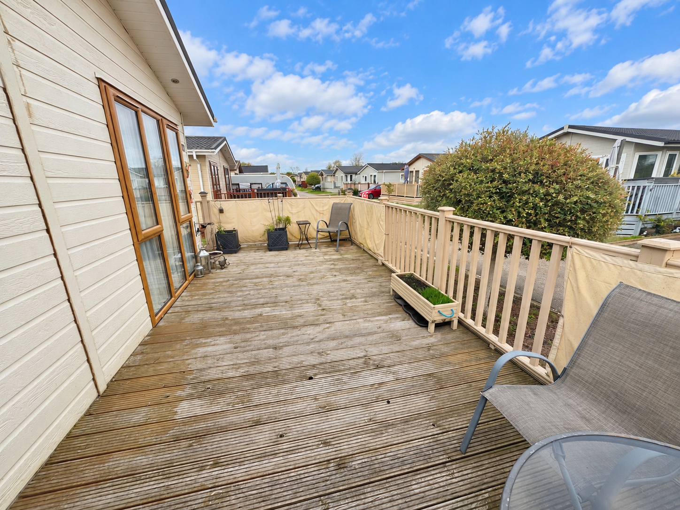
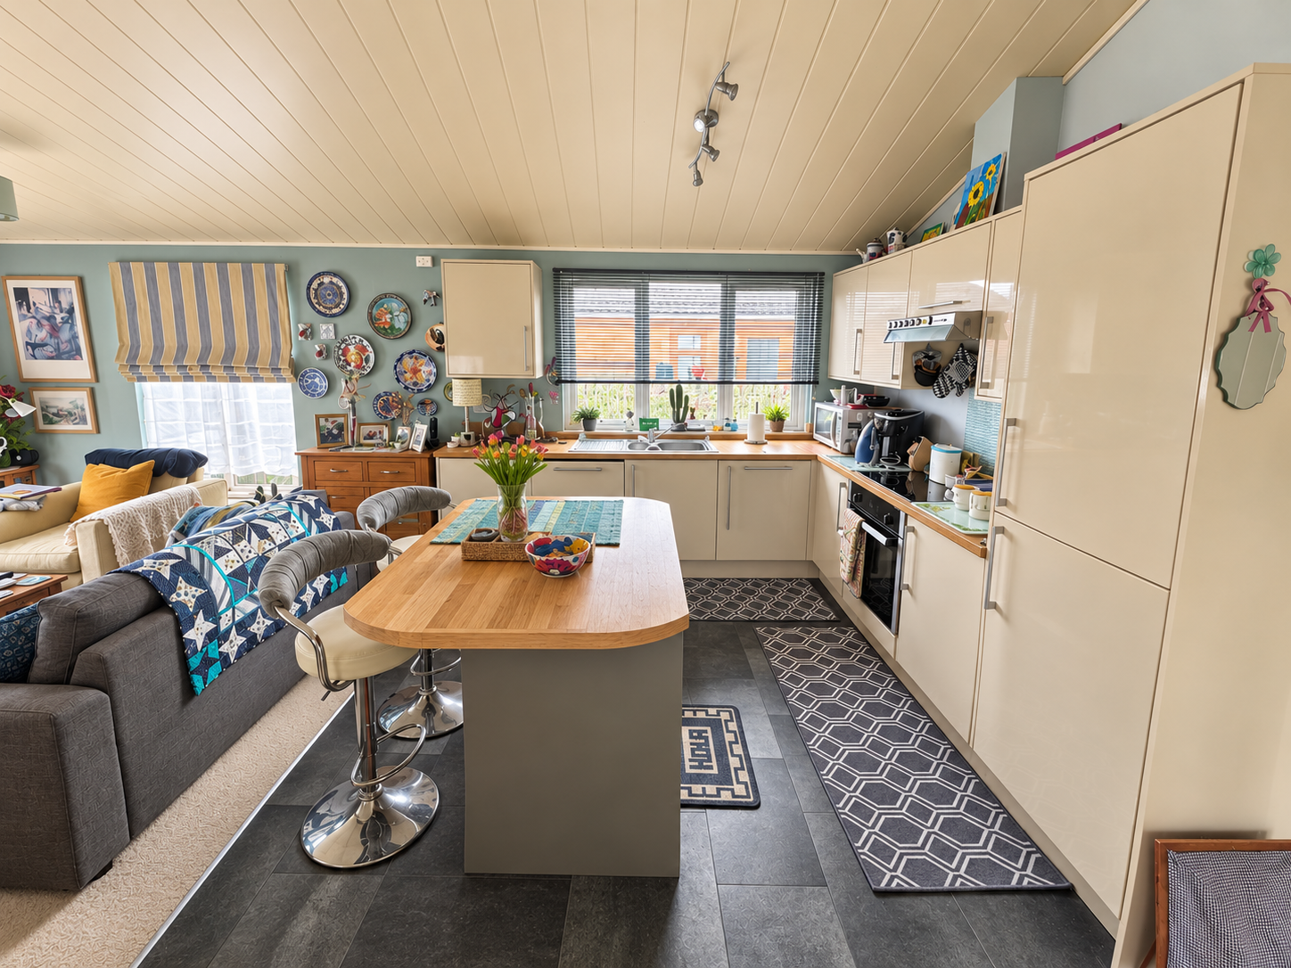
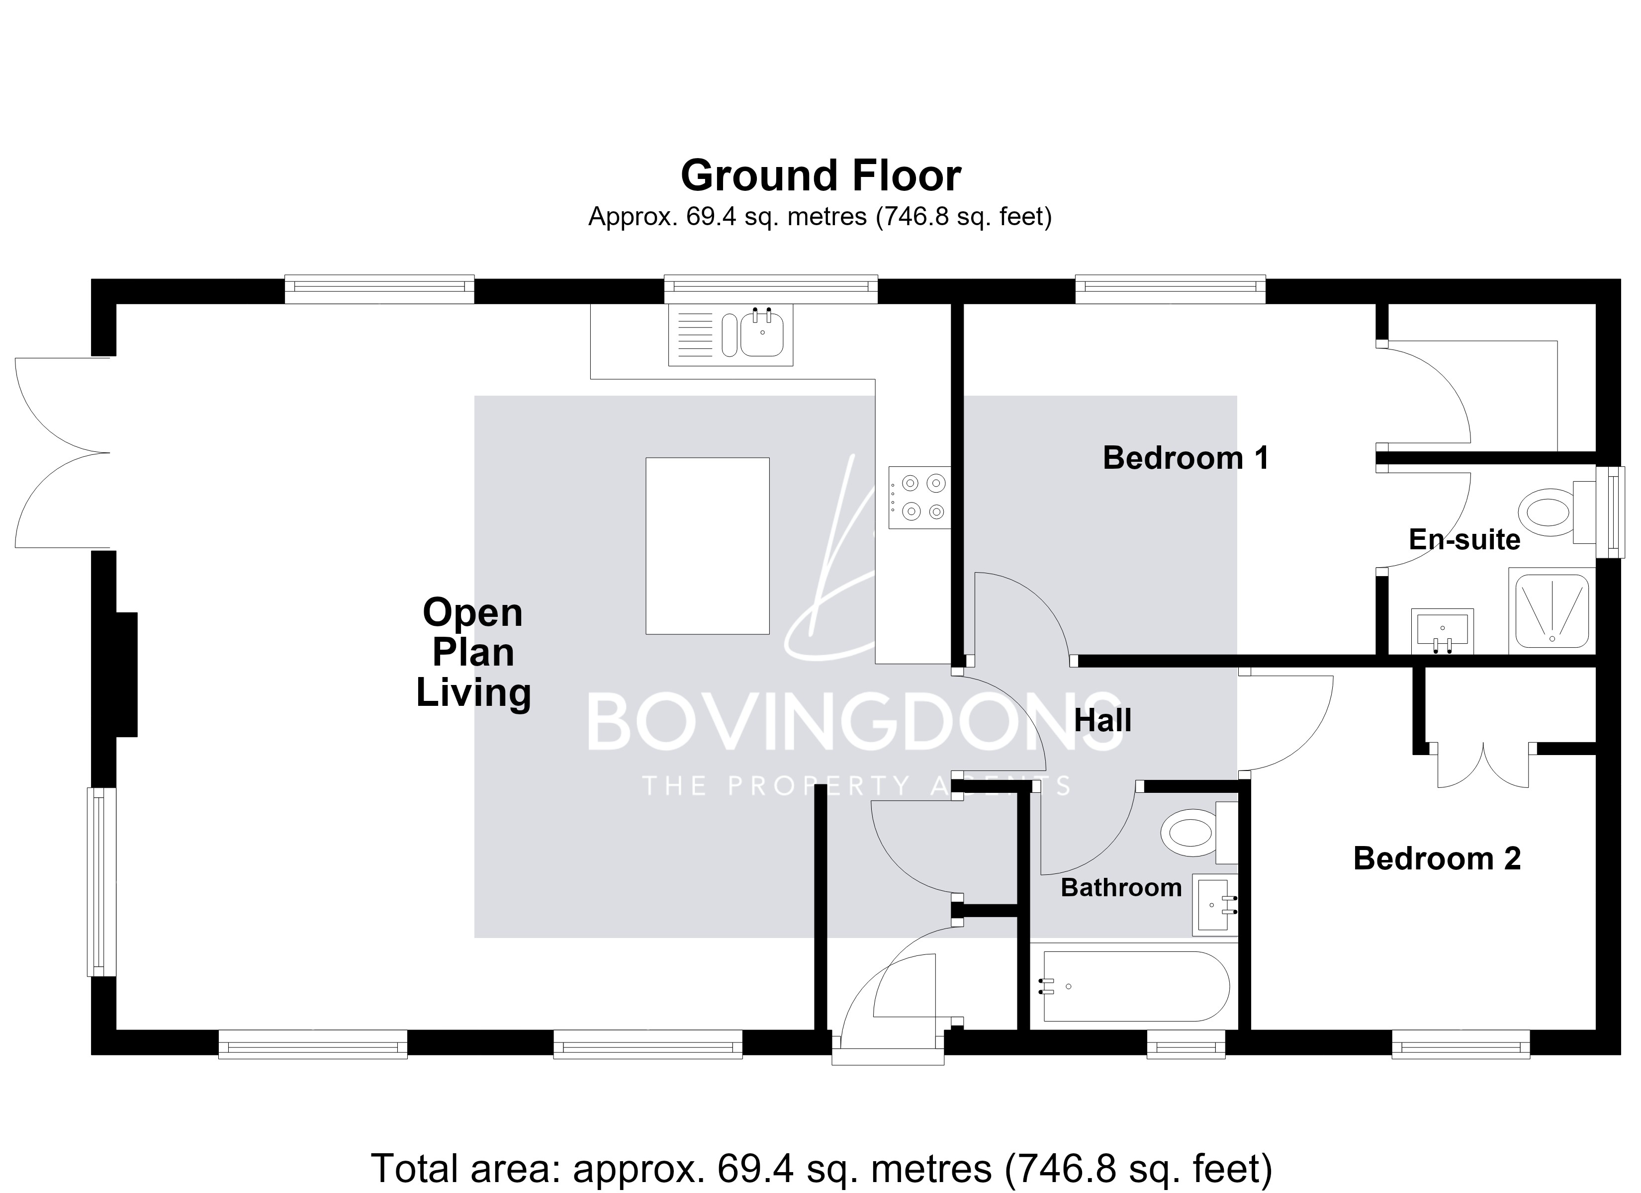
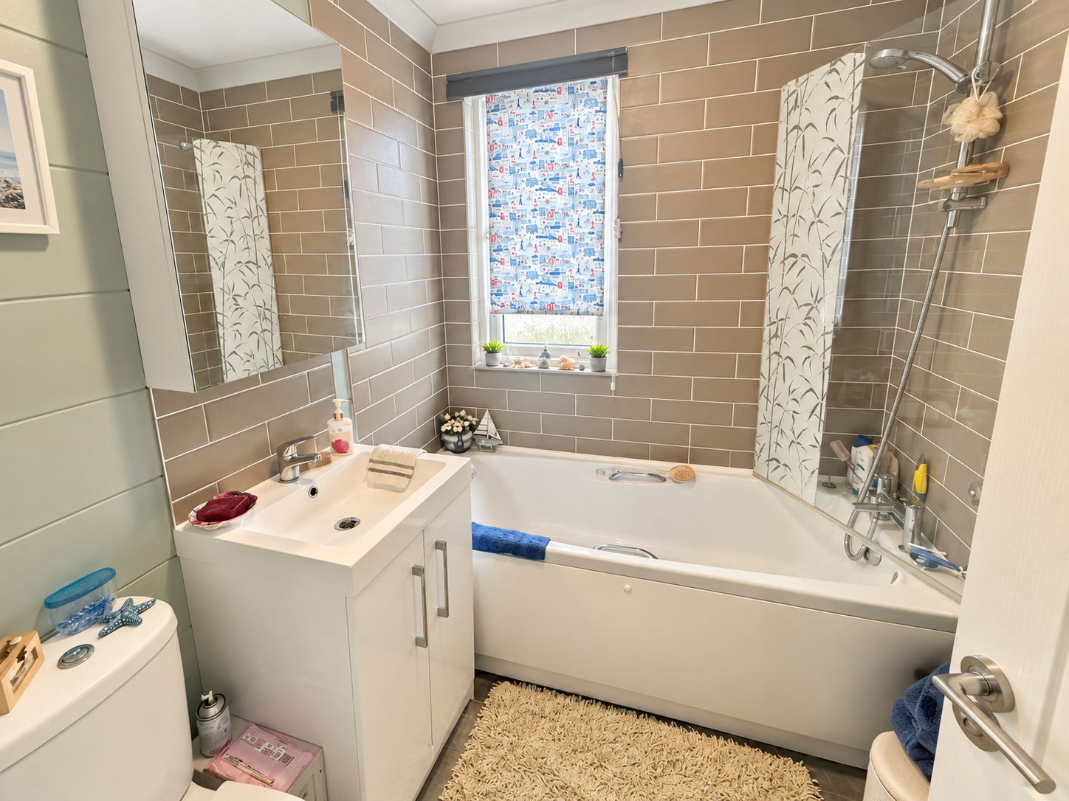
Lobby
Part glazed entrance door. Storage cupboard and further cupboard housing the Duo Tec LPG gas fire boiler serving central heating and hot water. Opens into the living area.
Open Plan Living - 6.71m x 5.84m (22'0" x 19'2")
Vaulted ceiling with four ceiling light points and five double glazed windows to front and side aspects and double- glazed patio doors to the front deck. Three radiators. Electric flame effect log burner with surround. Range of kitchen units at base and wall level with roll top work surfaces and incorporating a one and a half bowl stainless-steel sink with mixer tap. Integrated dishwasher. Integrated washing machine. Integrated fridge freezer. Integrated single oven with 4-ring Induction hob over and extractor above.
Inner Hall
Access to loft space. Ceiling light point.
Bedroom 1 - 3.3m x 2.82m (10'10" x 9'3")
Double glazed window to the side aspect. Radiator. Coved ceiling with light point.
Dressing Room - 1.68m x 1.22m (5'6" x 4'0")
Shelving and hanging rails to two sides. Coved ceiling with light point.
Ensuite - 1.68m x 1.52m (5'6" x 5'0")
Corner shower cubicle. Wash basin in vanity unit with mixer tap. Tiled splash areas. Low level WC. Radiator. Double glazed window to the rear aspect. Extractor fan. Coved ceiling with light point.
Bedroom 2 - 2.92m x 2.77m (9'7" x 9'1")
Double glazed window to the side aspect. Radiator. Coved ceiling with light point. Built-in double wardrobe.
Bathroom - 1.88m x 1.68m (6'2" x 5'6")
Panelled bath with mixer tap. shower attachment and screen Tiled splash areas. Wash basin in vanity unit with mixer tap. Low level WC. Radiator. Double glazed window to the side aspect. Coved ceiling with light point. Extractor fan.
Outside
The property sits to the rear of the site and is accessed via a secure gated entrance.
To the front of the property is a raised timber deck area access via the living area and extends to the side to the entrance door. There is a small garden shed and store to the rear of the lodge and a gas meter cupboard and outside water tap. There are communal gardens areas to the side and rear. There is an outside electric point by the front door.
Property Information
Local Council is East Cambridgeshire District Council - Council Tax Band is A
Site Rent is circa £408 per month.
Mains water and electricity is connected, and drainage is to an onsite private tank and both heating and hot water is from LPG (Flogas).
Flood Risk is low.
Restrictions apply but there are no Easements, Wayleaves or Rights of Way
Estimated broadband speeds are Standard 7mbps, Superfast 48mbps & Ultrafast 1800mbps
Cash purchasers only as Park Homes are not mortgageable.
Park Home rules apply (Ask for details)
Floor Plans
These particulars, whilst believed to be accurate are set out as a general outline only for guidance and do not constitute any part of an offer or contract. Intending purchasers should not rely on them as statements of representation of fact but must satisfy themselves by inspection or otherwise as to their accuracy. No person in this firm's employment has the authority to make or give any representation or warranty in respect of the property.
41a High Street, Soham, Ely, Cambs, CB7 5HA
Tel: 01353 725723 Email: info@thebovingdons.co.uk https://www.thebovingdons.co.uk

